Slide 1




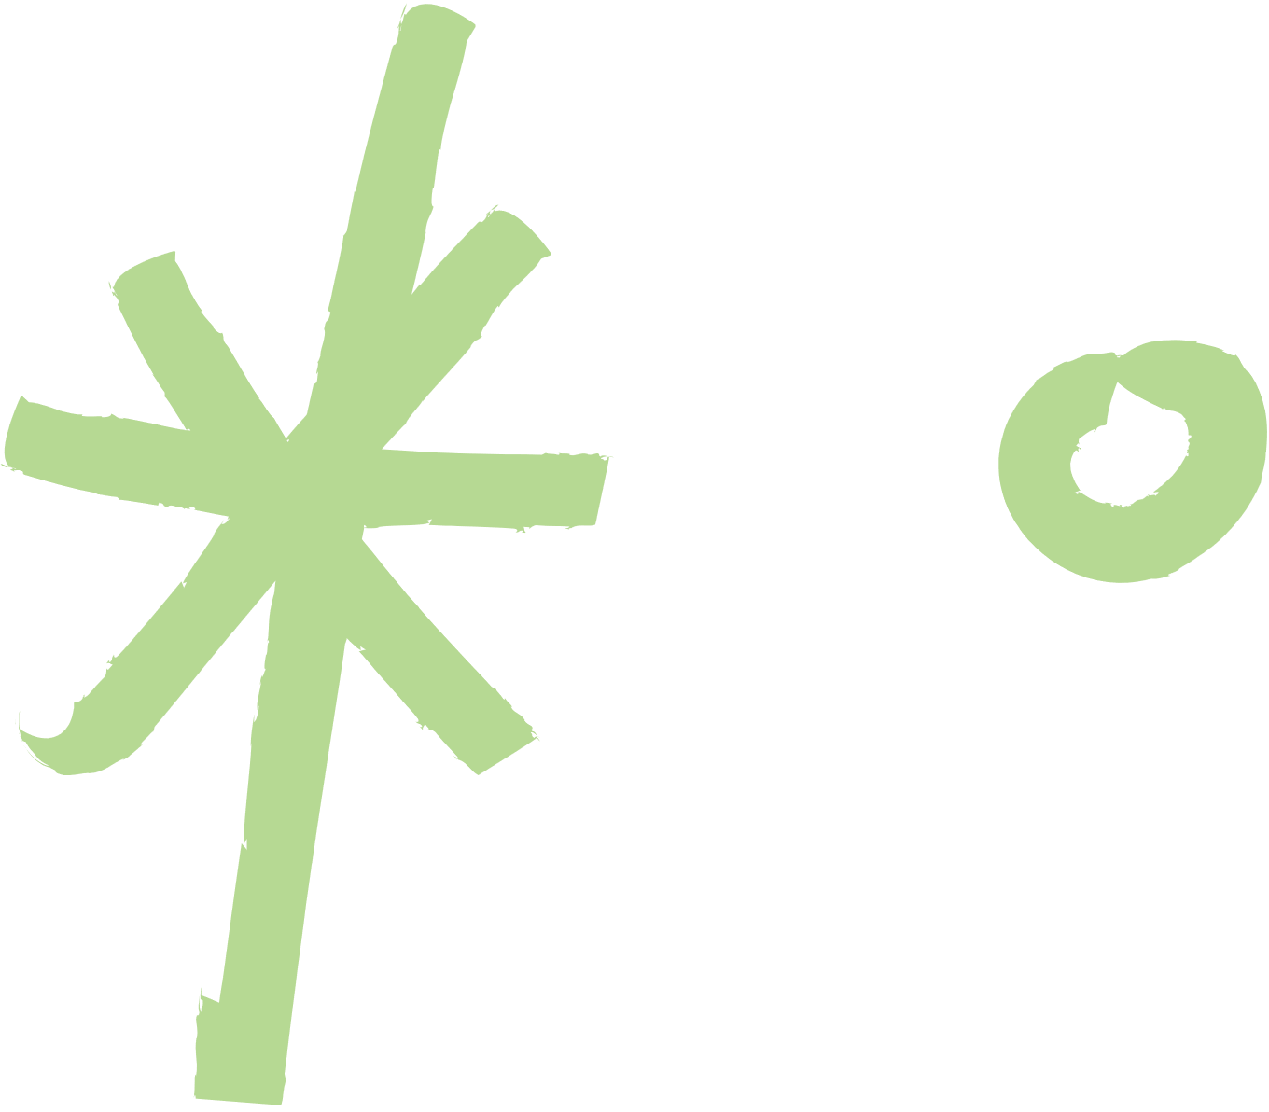

COLLECTIVE WORKS IN CREATIVE COMMONS
AMY ALBAUGH

Slide 2




INTRODUCTION
CREATIVE COMMONS COLLECTIONS AND REMIXES
Creative commons allows people to collect, remix and adapt works in various ways.
The licenses authors select determines the level of changes and derivatives that can be made.
AMY ALBAUGH
NOVEMBER 23

Slide 3
COLLECTIONS
WHAT IS A COLLECTION?
The ND (No Derivatives) option in CC licenses allows creators to specify that no publicly available adaptions are permitted under this license. However the nature of the CC allows for works to be copied and distributed. They may also be collected into a group with other like pieces for distribution and/or display. Such collection may reach a point of being an independent entity entitled to their own license though every piece in the collection still retains their own license and itself is largely unchanged.
examples of collections include online picture archives, collections of poetry from various authors with unique cover and introduction/commentary. The collection this combinations of specific pieces can be licensed as appropriate but each piece is separate and retains it’s own license.
AMY ALBAUGH
NOVEMBER 23

Slide 4




LICENSING COLLECTIONS
When you have a collection each piece retains their respect license and rights and you cannot change those licenses. If you have added any material to your collection like an introduction or a cover you can license the arrangement of the collection and the original parts of the work, but not the actual piece of the collection.
NOVEMBER 23
AMY ALBAUGH
MARCH 2023
WARNER & SPENCER

Slide 5



MY COLLECTION
I have creative a collection of 3D designs that are available under CC for people to use as 3d print files. The collection is hosted on Thingiverse and is collection called Characters. The files selected are for the production of armatures that can be used as toys or in other creative projects.
Here’s the link to my collection:
https://www.thingiverse.com/aalbaugh/collections/40228632/things
NOVEMBER 23
AMY ALBAUGH
MARCH 2023
WARNER & SPENCER

Slide 6

REMIXES, ADAPTATION AND DERIVATIVE WORKS
Where a collection retains the separation between each component, a remix or adaption will edit, combine and reconfigure a single or multiple works into a new piece of work.
If a collection is like a photo album, an adaption is like a composite picture.
of course not all edits to an original piece constitutes an adaption, if you’re correcting grammar and spelling, upping the quality of the an image file. Then those do not rise to the level of derivative works.
The thing to remember in an adaptation or a remix if you can pull the piece out whole then it wasn’t adapted it was inserted. You can include excerpts of texts and pictures, but until there’s no way to see where one piece begins and the other ends it’s not an adaptation in the truest sense of the term.
NOVEMBER 23
AMY ALBAUGH
MARCH 2023
WARNER & SPENCER

Slide 7


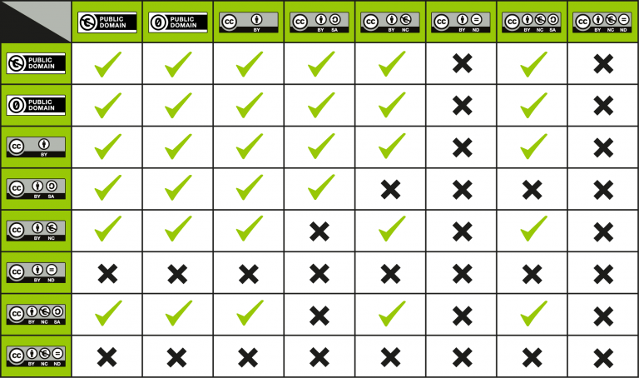




LICENSING FOR REMIXES / ADAPTED WORKS / DERIVATIVE WORKS
When licensing a remix or adaptation it must be compatible with the existing CC licenses of each piece.
If any of the parts have a ND clause then you don’t have to worry about any additional licensing because any adaption you have made cannot be distributed per the license.
SA (Sharealike) licenses must have an adapter license the same as the original work. And NC licensed items cannot be use in commercial projects.
NOVEMBER 23
AMY ALBAUGH
MARCH 2023
WARNER & SPENCER

Slide 8


LET'S CREATE

Slide 9



SOURCES
All information provided was sourced from :
https://certificates.creativecommons.org/cccertedu/
COLLECTIVE WORKS IN CREATIVE COMMONS © 2023 BY AMY ALBAUGH IS LICENSED UNDER CC BY 4.0

