Slide 1
Facilitate This: Group Discussions & Responsive Librarianship
For: EME6613 under the guidance of Dr. Yiping Lou
11/26/2021
By: Tracie Cooper, Maryellen Nash, Amy Albaugh
Notes:
Tracie: Hi everyone! Tracie, Maryellen, and Amy here to present our project, Facilitate This: Group Discussions & Responsive Librarianship.

Slide 2
Evolution of Librarianship
Librarians are increasingly called upon to provide social services yet lack formal training.
As social services continue to be understaffed and underfunded this leaves the local public library as one of the few remaining resources.
Library Social Workers
“A librarian is trained to be a manager, a collection development expert, a curriculum leader, a technology resource, and a teacher, working sometimes one on one with individual students in developing literacy and 21st Century information skills.”
- Maureen Hance, MDR Market Insight Project Manager
Notes:
Tracie: As we learned through this project, libraries have evolved and as such the role of librarians has evolved as well. Librarians are often called upon to provide services to patrons that are outside the traditional role of the librarian as information guide.
Increasingly, libraries and librarians are faced with patrons who are in need of social services above and beyond the normal information-based transactions for which librarians are trained.
As library science programs shift towards more community outreach, the emerging practice of library social workers continues to grow as well. In some libraries, teams of interdisciplinary professionals are working together using responsive librarianship to address community mental health and wellness needs.

Slide 3
Project Background and Rationale
Responsive Librarianship
Expands upon bibliotherapy and readers’ advisory.
Involves asking questions to solve problems and to improve mental health outcomes.
Focuses on open communication, strategies to encourage empathy and positive self-care.
Notes:
Tracie: Responsive librarianship is the delivery of personalized library services in response to a specific need (Cannon, 2019). It expands on the concepts of bibliotherapy and readers’ advisory. Responsive Librarianship involves asking questions to solve problems and to improve mental health outcomes and it focuses on open communication, strategies to encourage empathy and positive self-care.

Slide 4
Project Background and Rationale
Notes:
Tracie: We were tasked by USF's School of Information Responsive Librarianship Lab, as part of the Libraries Build Communities Program to develop a scenario-based learning experience using responsive librarianship communication strategies to facilitate group discussions around themes in literature for adolescents.

Slide 5
Target Learners Librarians, Library-school students, Library Social Workers
Notes:
Tracie: Our target learners are librarians, library-school students, and/or library social workers.

Slide 6
Project Goal
asynchronous, scenario-based learning game
librarians and social workers
promoting the development of group facilitation skills for adolescent participants
Notes:
Tracie: The goal of our project was to create an asynchronous, scenario-based learning game for librarians and social workers that promotes the development of group facilitation skills for adolescent participants. Fostering engagement and promoting empathy were areas of focus.

Slide 7
Theoretical Frameworks
Successive Approximation Model (SAM)
Design Based Research (DBR)
Sites, R., & Green, A. (2014). Leaving ADDIE for SAM field guide: Guidelines and templates for developing the best learning experiences. American Society for Training and Development.
Barab, S. A. (2014). Design-based research: a methodological toolkit for engineering change. In K. Sawyer (ed.) Handbook of the Learning Sciences, Vol 2, (pp. 233-270), Cambridge, MA: Cambridge University Press.
Notes:
Maryellen- Our theoretical frameworks drew from components of the Successive Approximation Model and Design Based Research. Both models emphasize a reiterative and recursive progression that allows for rapid prototyping and multiple iterations of a project throughout the design phase. DBR can be differentiated from SAM in the inclusion of the research-related aspects of the project, which for us hinged on our research question and the results of our alpha and beta survey results which connects our design process with selected design methodologies. Our team started with background information from the SME and then we met to discuss the design, storyboard a prototype, obtained review feedback from the SME and other stakeholders (Dr. Lou, classmates), which informed the next iterations repeating the same process for the alpha and beta phases.

Slide 8
Overall Instructional Design Approach & Learning Theories
Overall Approach: Constructivism
Learning Theories:
Experiential Learning Theory
Situated Learning Theory
Notes:
Maryellen
Constructivist theory holds that learners build upon their own previous experiences and knowledge to make sense of and encode new knowledge, so that each person's previous experiences, beliefs, and understandings form the foundation for their continued learning. In our case, our project builds upon the existing knowledge and experiences common to librarians who likely have had experiences with leading book talks, book discussions, and working with adolescent patrons.
In addition to a constructivist approach, Kolb's Experiential Learning Theory helped to inform the overall game design. Kolb suggests that learners progress through a learning cycle consisting of four stages: concrete experience, observation and reflection, formation of conclusions, and finally testing those conclusions in novel situations. In our case we attempted to simulate a concrete experience with realistic scenarios that prompt reflection from the learner when they are asked to select a solution to a proposed problem. Their choice results in a conclusion, either desirable or not, at which point they are invited to reflect on the consequences of the choice.
Finally, we drew upon situated learning theory which emphasizes learning and problem solving utilizing realistic and relevant situations. In addition, this learning theory positions the instructor in the role of "guide" or "coach" rather than lecturer while the learner is cast in the role of an "apprentice" who acquires knowledge and understanding as a result of real-world experience. Obviously, there was some departure from this as a simulation was as close as we could get to a "real world" experience.

Slide 9
Instructional Design Principles
Cognitive Theory of Multimedia Learning (Clark & Mayer)
Manage learners' cognitive processing
ARCS Model (Keller)
Gain attention
Create relevance
Increase confidence
Support satisfaction
Notes:
Maryellen
Our instructional design principles for the game were based upon Clark and Mayer's Cognitive Theory of Multimedia along with Keller's ARCS Model.
The underlying assumption with multimedia learning is that information should be designed and presented in accordance with the workings of the human mind, and that instruction designed around human information processing systems are more likely to lead to meaningful learning (Mayer, 2014).
Keller's ARCS Model (attention, relevance, confidence, and satisfaction) addresses learner motivation and the four elements that instructional designers can use to enourage and sustain learner engagmement.
Strategies of the ARCS Model that were considered to increase learner motivation consisted of attention gaining, relevance creation, increasing confidence, and satisfaction support. Each strategy was addressed through the use of real-world examples, active participation, scoring, and feedback. Active learner participation was accomplished through the decision points within the game. After the learner was presented with a realistic background story and conflict scenario, a choice of three scored resolution paths, each resulting in a more to less-favorable outcome, was introduced. The learner (who was cast in the role of discussion group facilitator) decided how best to proceed and was immediately provided with the consequence of the decision and additional information explaining why the learner did or did not make the best choice. Thus, both intrinsic and instructional feedback was given, depending upon the pathway selected.

Slide 10
Multimedia Learning Principles
A combination of voice-over narrations, animated and still graphics, and textual elements were combined, being careful to observe several principles of multimedia learning including:
The Segmenting Principle: People learn better from a multimedia lesson presented in user-paced segments.
The Modality Principle: People learn better from graphics and narrations than from animation and on-screen text
The Multimedia Principle: People learn better from words and pictures than from pictures alone.
The Personalization Principle: People learn better from multimedia lessons when words are in a conversational style.
Image source: Mayer, 2008
Notes:
Maryellen
Segmenting principle: This module was broken into two separate scenarios, each addressing one aspect of group discussion facilitation: Setting ground rules/steering discussion, and creating/using empathetic, open-ended questions to further engagement.
Modality Principle: This module employed a varity of graphics, animation and narration. Animated clips included narration, but due to limitations of the design team, we were not always able to avoid animation with on-screen text.
Multimedia principle: The design team was always careful to include pictures and graphics along with words where appropriate and possible.
Personalization principle: The script for the scenarios and the narration for the guide character was always presented in an informal, conversational style.

Slide 11
Research Question
Desired outcome: Increased librarian efficacy in social service activities like group discussions addressing aspects of mental wellness aimed at adolescents.
Do librarians who engage in group discussions with adolescent patrons as part of the Responsive Librarianship program find that targeted, game-based training helps them feel more confident in their ability to facilitate effective and empathetic group discussions?
This Photo by Unknown Author is licensed under CC BY
Notes:
Maryellen
Our research question focused on the perception of the level of confidence of librarians particpating the in the Responsive Librarianship program with respect to their confort level in facilitating group discussions with adolescent patrons.

Slide 12
Design and Development Process (including development platform selection, roles of group members, group collaboration channels and processes,
Platform selection
Storyline was required
Powtoon adopted at the suggestion of professor
Roles of group members
Videos – Tracie Cooper
Storyline construction – Amy Albaugh
Research/Script – Maryellen Nash
Group collaboration channels and processes
Teams
Chat
Live Meetings online
Shared documents
This Photo by Unknown Author is licensed under CC BY
This Photo by Unknown Author is licensed under CC BY-SA-NC
Notes:
First, the mechanics of our team project: We used Storyline since that was a required component and we also included animated videos made in Powtoon which was an addition suggested by Dr. Lou.
For the responsibilities, Tracie created the PowToon videos and was the voice of our guide character. Amy put together the pieces in Storyline, and I was responsible for conducting the research, building the story arc and writing the script.
We collaborated using the Teams environment for live discussions, chat messages and shared documents.

Slide 13
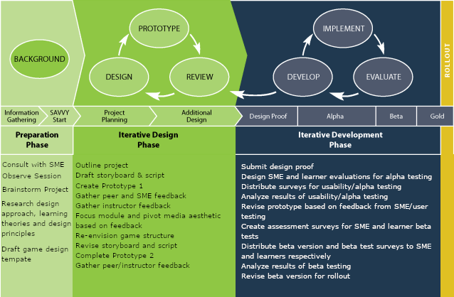
Design and Development Process
Notes:
Consultation with practitioners, SME review, one-on-one learner evaluations, field implementation
Met with Denise to review project.
Had her look at early iterations and made changes based on her comments.
Peer evaluation and revisions
Made several changes based on peer comments
Made dozens of small and large changes based on SME feedback.

Slide 15
Iteration 1 Design Proof Reviews
Notes:
Amy- Original concept captures. Desire for a realistic approach and a desire for a complex course structure a branching design. The original concept was very complex with several scenarios that would branch off into separate decision trees.

Slide 16
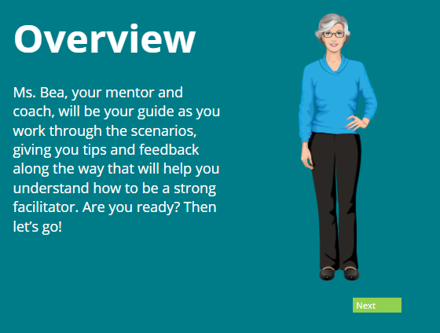
Iteration 1 Design Proof Reviews and Revisions
The first Ms. Bea!
Notes:
Amy- Original Ms. Bea inline with original aesthetic.
We had a meeting with Denise and spoke to her about the goals for the project. She expressed concerns about the broad scope of the project, and our review from Dr Lou made us rethink the photorealism.

Slide 17
Iteration 2 Alpha Tests and Revisions
Notes:
Amy- Enter powtoons. For the official Alpha tests we created a handful of powtoons videos starting with this one that’s a very upbeat intro for our new Ms. Bea.

Slide 18
Alpha Testing
17 Likert scale questions, divided into 5 sections
Navigation
Media
Interactivity
Content
Potential for learning
Open-ended comment boxes
Notes:
The team opted to conduct a survey for alpha testing due to the lack of direct access to the librarians in the Responsive Librarianship program and limitations due to time.

Slide 19
Alpha Test: Compiled Survey Results
Players Survey Summary
SME survey summary
Strongly agree | 9
Somewhat agree | 13
Neither agree nor disagree | 6
Somewhat disagree | 4
Strongly disagree | 0
Strongly agree | 13
Somewhat agree | 4
Neither agree nor disagree | 0
Somewhat disagree | 0
Strongly disagree | 0
Notes:
Maryellen
The results from the alpha testing survey were mostly positive. Both the SME and general user surveys followed the same basic survey design. Each survey was divided into five sections, addressing one aspect of the module design: navigation, media, interactivity, content, and potential for learning. Each section contains an open-ended text response area at the end for any additional comments that the respondent may wish to make. The SME survey differed from the general user survey in matters of perspective. For example, in the SME survey, evidence of learning is framed in terms of the skills that the SME would expect a user to gain from the module, whereas the same question for the general user is presented as a request to list the skills and knowledge gained after experiencing the module.
Of the 17 Likert scale questions on the survey, the SME selected “Strongly agree” with the question statement in 76% of the responses. The remaining 24% reflected “Somewhat agree”. Of the questions that rated lower (“Somewhat agree”), the majority of those (three out of four) addressed the navigational aspects of the module. More specifically, ease of navigation and element performance, accessibility of embedded elements, and the level of appeal with color, graphics, and narration were the items that did not perform as well. The remaining “Somewhat agree” response was found in the “Interactivity” section and related to the level of engagement in the module interactions.
Player survey responses
The 6 “neither agree nor disagree” responses were each of the players answers to two questions regarding other content within Story Strong Responsive Librarianship Program. The players indicated they are not familiar with the program and thus could not comment.
Responses that elicited the lowest ratings (Somewhat disagree) were evenly distributed among the sections, including Navigation (2), Media (1), and Interactivity (1).
Specifically, player respondents rated understandability of module progress, ease of navigation, animation/narration synchronization, and the understandability of module character conversational exchanges as areas for improvement.

Slide 20
Open-Ended Responses
Each survey provided the opportunity for additional feedback
Very valuable and provided information that we couldn't obtain from just the likert scale questions.
Notes:
Maryellen
Open-ended responses provided at the end of each section indicate that confusing elements in the module introduction that relate to video controls, the rate of presentation of character speech bubbles, and one suggestion that all character speech be converted to narration provided valuable insight on avenues for module improvement.
Player participants also made a few additional comments in our 360 review file. All feedback was collated for further review.

Slide 21
Beta Test Survey Instruments
Same basic design as Alpha survey
Both SME and Learner/Player survey had 5 sections
Navigation
Media
Interactivity
Content
Evidence/Potential of/for learning
Two additional questions relating to perceived knowledge and confidence levels
Notes:
Both the SME and general user surveys follow the same basic survey design. Each survey is divided into five sections, addressing one aspect of the module design: navigation, media, interactivity, content, and potential for learning. Each section contains an open-ended text response area at the end for any additional comments that the respondent may wish to make. The SME survey differs from the general user survey in matters of perspective.
The beta test focused more on the perception of the impact of changes made to the learning game that resulted from alpha testing feedback. In addition, testers sought more information on evidence of learning by including two additional questions relating to previous user knowledge and subsequent perceived confidence levels after playing the beta version of the game.

Slide 22
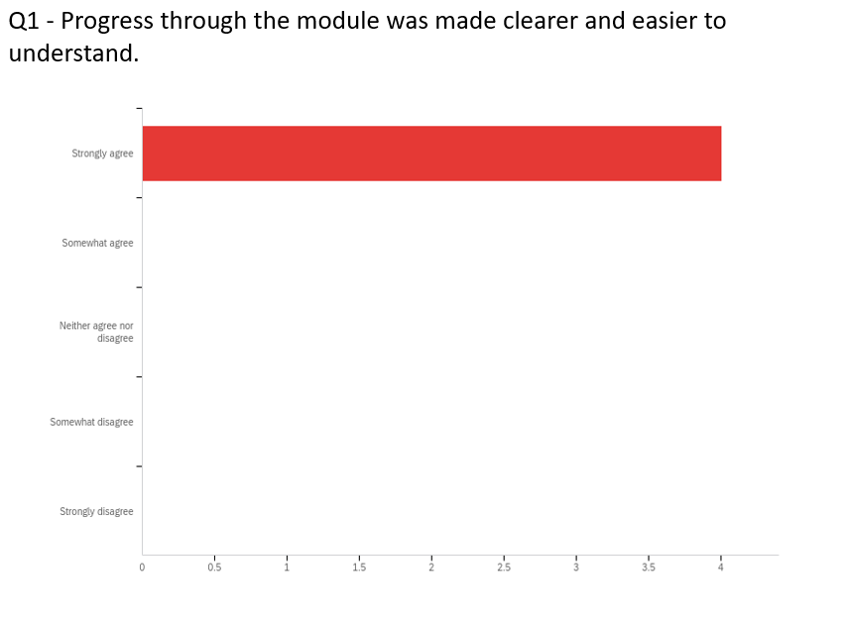
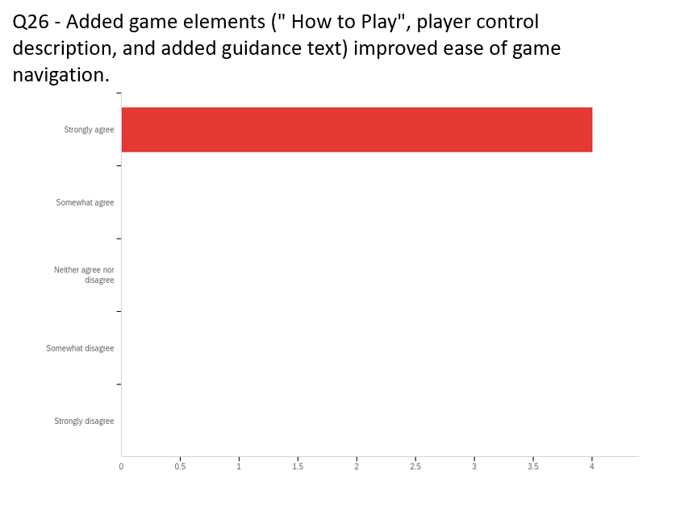
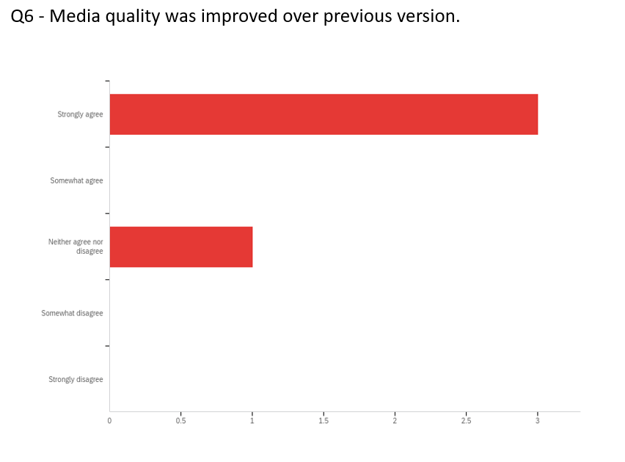
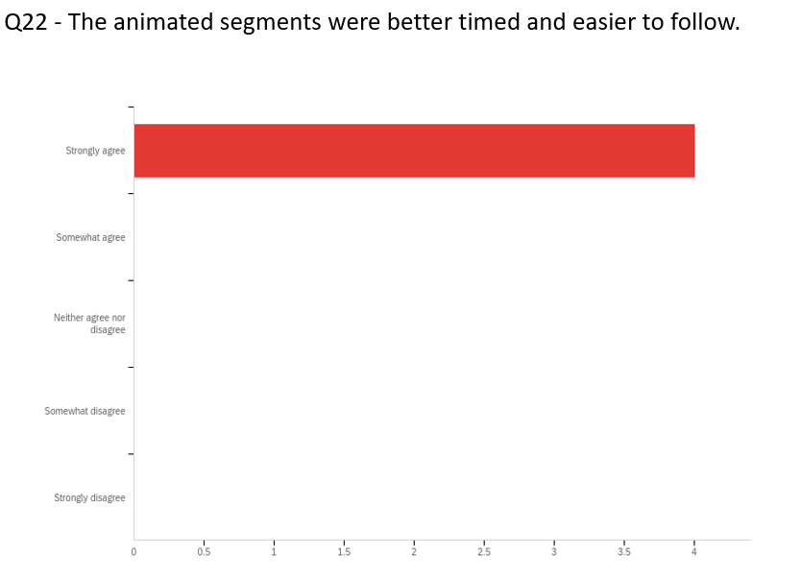
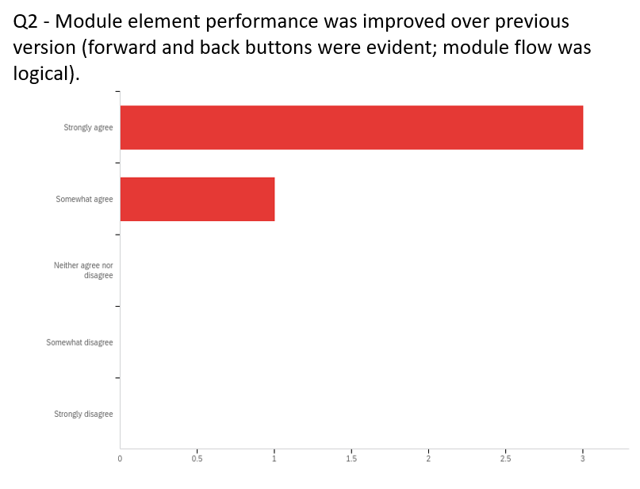
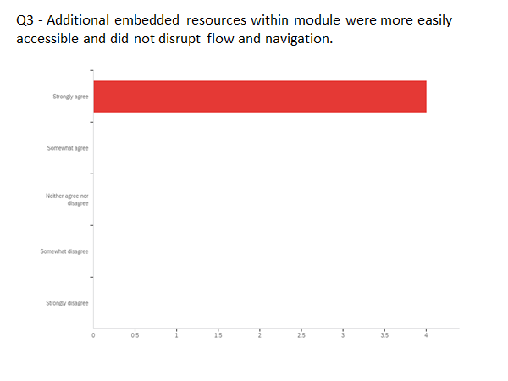
Iteration 3 Beta Tests
Notes:
Maryellen
For the Learner/player survey, responses moved in a positive direction for 12 of the likert scale questions. 3 saw no change and 1 had a negative change. The negative change question asked if changes in media elements made the module more appealing. Open-ended responses indicated that there weren't any real noticeable changes and that the media aspects were fine before.

Slide 23
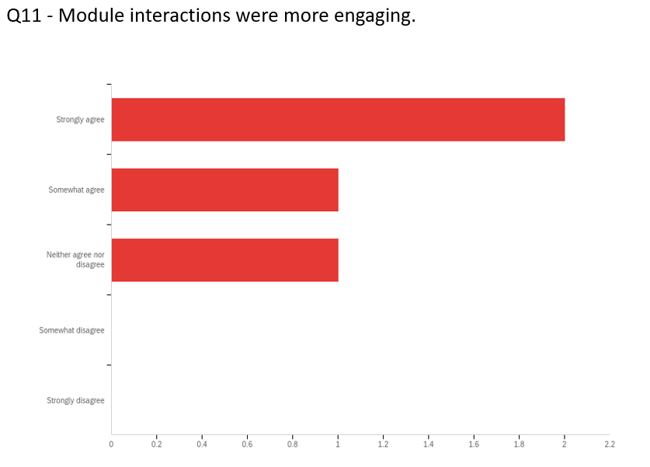
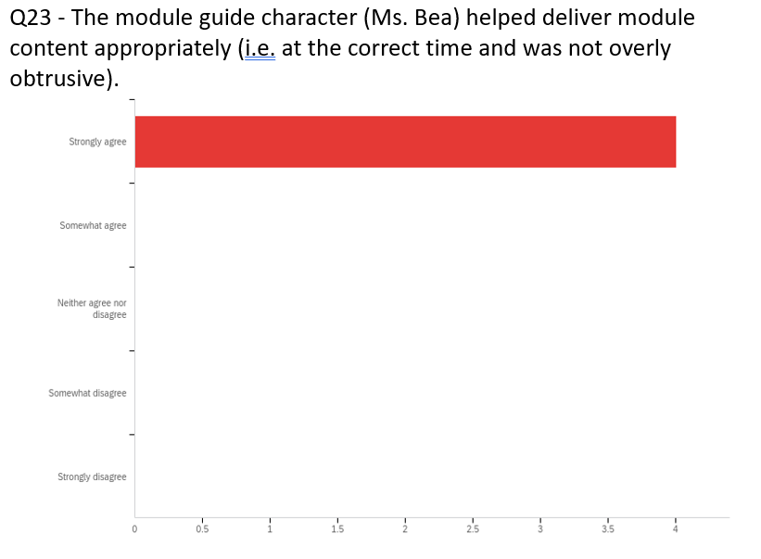
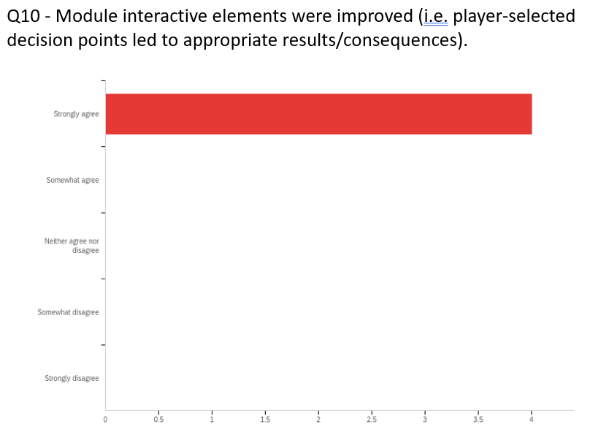
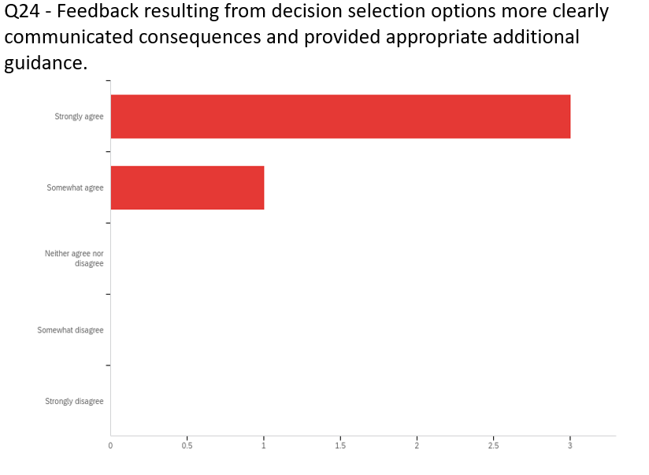
Highlights of Beta Test Results

Slide 24
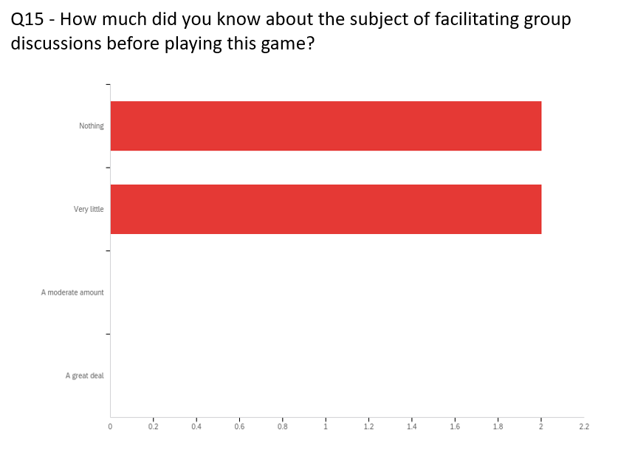
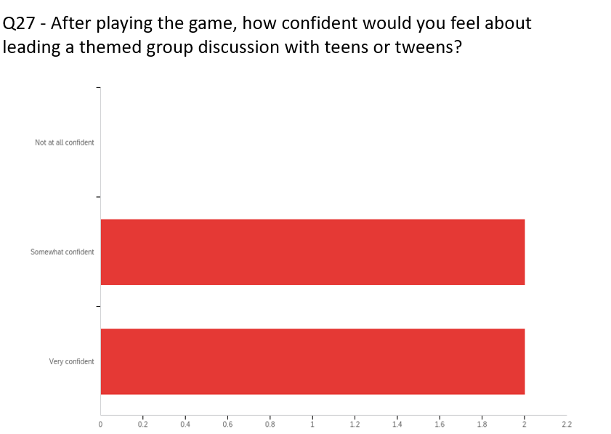
Evidence of Learning & Perceived Confidence

Slide 25
Iteration 3 Beta Test Results – “Strongly Agree”
Q1 | Q2 | Q26 | Q3 | Q6
Progress through the module was made clearer and easier to understand. | Module element performance was improved over previous version (forward and back buttons were evident; module flow was logical). | Added game elements (" How to Play", player control description, and added guidance text) improved ease of game navigation. | Additional embedded resources within module were more easily accessible and did not disrupt flow and navigation. | Media quality was improved over previous version.
4 | 4 | 4 | 4 | 4
Q10 | Q11 | Q12 | Q24 | Q25
Module interactive elements were improved (i.e. player-selected decision points led to appropriate results/consequences). | Module interactions were more engaging. | Interactions were appropriate for a professional audience, like librarians or social workers. | Feedback resulting from decision selection options more clearly communicated consequences and provided appropriate additional guidance. | Conversation exchanges among game characters was easier to read and follow over previous version.
4 | 4 | 4 | 4 | 4
Q7 | Q8 | Q22 | Q23
Narration was more understandable and consistent. | Narration and animation were better synchronized. | The animated segments were better timed and easier to follow. | The module guide character (Ms. Bea) helped deliver module content appropriately (i.e. at the correct time and was not overly obtrusive).
4 | 4 | 4 | 4
Notes:
Maryellen
For the Learner/player survey, responses moved in a positive direction for 12 of the likert scale questions. 3 saw no change and 1 had a negative change. The negative change question asked if changes in media elements made the module more appealing. Open-ended responses indicated that there weren't any real noticeable changes and that the media aspects were fine before.

Slide 26
Beta Test Comments
Q17 | Q19 | Q21
Any additional comments on module content? | Please list two to three new skills or information that you have learned after experiencing this module. | Is there anything about this game that you would change to improve it?
it's minor, but I noticed that it looks like the "correct" answers for each scenario are in order so that the right one is always at the top. was that on purpose? | How to use better questions in group discussions Be mindful of language used in asking questions Setting ground rules for discussions | This was really a lot better this time. It just flowed better, and I really liked the addition of the "prev" "next" buttons instead of just the arrows. Good job!
Lots clearer. Everything worked well. | How to start a group discussion and how to structure discussion questions. | It soooo minor, but I still wish the characters had voices.
 | Getting ready for group discussions, and how to ask good discussion questons. | Maybe change the order of the questions? The best choice was always first.
 | why it's important to set ground rules; How to ask the best questions for discussions

Slide 27
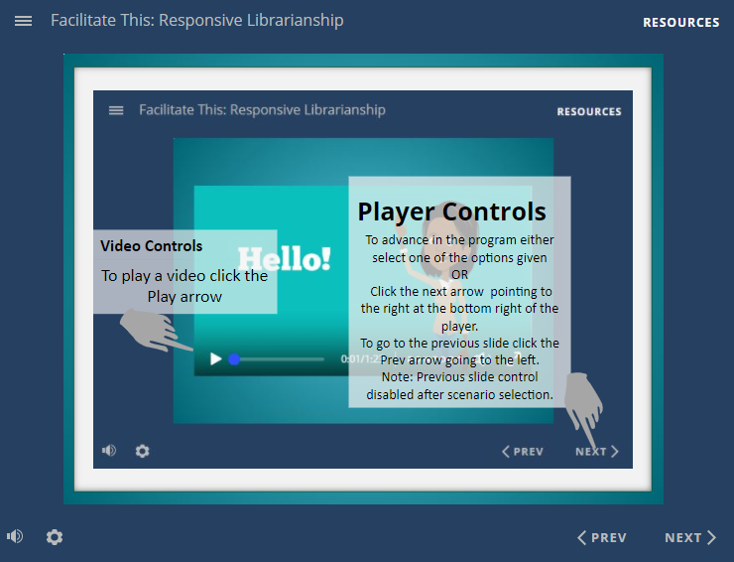
Iteration 3 Revisions
Notes:
Amy

Slide 28
Notes:
Amy – This shows the evolution of the project as a whole. Other revisions we made included making adjustments for timing on the videos, and animations. The way the text would appear for the scenarios. Lots of small adjustments based on the feedback we were getting both from the surveys and from our peers. Here's Tracie to talk us through the details of the final product.

Slide 29
Final Product Illustrations
Notes:
Tracie: We've included some final product illustrations to highlight the implementation of design principles. Here we have used tactics from the ARCS Motivational Design Model to gain attention through colorful visuals and to establish relevance by outlining learning objectives (which is goal orientation).

Slide 30
Final Product Illustrations
Notes:
Here we have provided user guidance, offered player controls, and illustrated our use of The Segmenting Principle.

Slide 31
Final Product Illustrations
Notes:
Tracie: In our scenario-based experience, we begin by introducing the learner to Ms. Bea, the guide character, and to the group of adolescent particpants – Jamal, Maggie, and Sammie.

Slide 32
Final Product Illustrations
Notes:
Tracie: Here we illustrate a tactic for increasing confidence through confirmational feedback and reinforcement of relevance through reminders of goal orientation.

Slide 33
Final Product Illustrations
Notes:
Tracie: By having the learner enter their name and referring back to them again offers an opportunity for the player to develop an emotional connection with the material.

Slide 34
Final Product Illustrations
Notes:
Tracie: Problem-based inquiry can capture and sustain attention. Feedback increases confidence and the point value of a game can provide extrinsic satisfaction.

Slide 35
Final Product Illustrations
Notes:
Tracie: Providing success opportunities is a confidence building strategy and reinforcing accomplishment supports learner satisfaction.

Slide 36
Discussion of Results
We produced a polished game that achieved the goals of the project.
The client is happy
We’re proud of the final product.
Notes:
Amy

Slide 37
Limitations
Time and experience
Scope
Other limits
Multimedia/Voiceover
This Photo by Unknown Author is licensed under CC BY-NC
Notes:
Amy –
Following from our initial plans we were confronted with the limitations we had with our collective time and experience with the technology involved and this forced us to drastically reel in the scope of the project we envisioned.
Another comment we had frequently was the mention of having the characters speak their lines instead of having them appear on screen in a speech bubble. This decision was brough about because we didn’t want to use autogenerated voices and the characters didn’t fit with our own voices and we felt that having us voice the characters in expertly might break the immersion in the scenario.

Slide 38
Recommendations on Design Principles
More complex and immersive scenario branching
All character narration voice-overs
Notes:
Tracie- As previously mentioned time was a limitation for project development. If time was not a barrier, we would recommend the use of expanded scenarios that offer more complex and immersive branching. Within these expanded scenarios, the Powtoon setting/arrangement could also be changed to increase variability as a tactic to further sustain attention.
Secondly, feedback from testing indicated a desire to have group characters with voice narration. The team discussed this multiple times throughout the project and with two characters being male and a desire by our team to avoid “computerized” voices, which is a violation of Mayer’s Voice Principle, we decided it was not feasible. In the future, with more time and resources we would recommended including narration voice-overs for all characters.

Slide 39
Recommendations for Future Design
Expand the program to explore other aspects of social service that can be provided through the library framework.
The scenario-based framework can be used like a block system. You can add more scenarios or swap out current ones for new ones.
One thought for the future would be to target training on different aspects of the responsive librarianship. This project focused on group discussions, another could look at group projects, or guest speaker guidelines. Things along those lines. Using this as a base it is possible to create scenarios for anything.
This Photo by Unknown Author is licensed under CC BY
Notes:
Amy

Slide 40
Recommendations for Research
Examine the impact this has on the profession and on the training given to librarians.
Survey before and after training and following several intervals.
Broader applications in the educational/social services
Use feedback to iterate future designs.
This Photo by Unknown Author is licensed under CC BY-SA-NC
Notes:
Amy – Generalizability

Slide 41
Questions?

Slide 42
References
Articulate 360. (n.d.). Build highly interactive E-learning courses with storyline 360. Articulate - The Most Popular E-Learning Authoring Apps and Online Training Software. https://articulate.com/360/storyline
Cannon, P. (2019). Taking an “Ecological Turn” in the Evaluation of Rhetorical Interventions. https://scholarcommons.usf.edu/cgi/viewcontent.cgi?article=9207&context=etd
Clark, R. C., & Mayer, R. E. (2016). E-learning and the science of instruction: Proven guidelines for consumers and designers of multimedia learning. john Wiley & sons.
Hance, M. (2018, April 10). The evolving role of the library and librarian. MDR a division of Dunn & Bradstreet. https://mdreducation.com/2018/04/10/evolving-role-library-librarian-library-week/%E2%80%8B
Keller, J. M. (2010). Motivational design for learning and performance: The ARCS model approach. Springer Science & Business Media.
Mayer, R. E. (2008). Applying the science of learning: Evidence-based principles for the design of multimedia instruction. American Psychologist, 63(8), 760–769. https://doi-org.ezproxy.lib.usf.edu/10.1037/0003-066X.63.8.760
Wahler, E. A., Provence, M.A., Johnson, S.C., Helling, J., Williams, M., (2021). Library Patrons’ Psychosocial Needs: Perceptions of Need and Reasons for Accessing Social Work Services, Social Work, Volume 66, Issue 4, October 2021, Pages 297–305, https://doi.org/10.1093/sw/swab032

